Slide 1
IEEE 802.11 Wireless Local Area Networks (Wi-Fi-LANs)

Slide 2
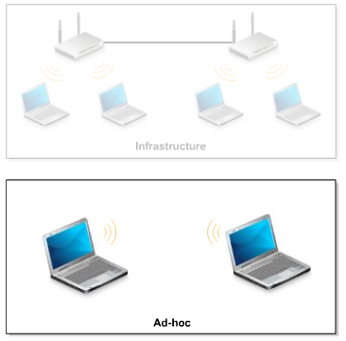
Types of Wireless LANs
Infrastructure (BSS and ESS)
Ad-hoc (BSS)

Slide 3
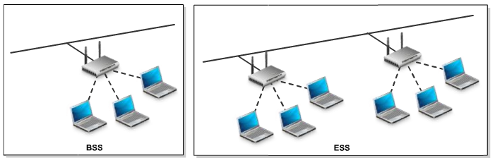
Wireless network implementation
SSID – 32 long alfanumeric string identifying the WLAN
BSS (Basic Service Set) – a network consisting of several clients and a wireless Access Point (AP); unique SSID
ESS (Extended Service Set) – a network consisting of several wireless AP; adds mobility, Aps can use different SSIDs

Slide 4
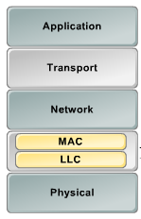
IEEE 802 LAN standards and TCP/IP model
The IEEE 802.x LAN standards deal with the DataLink and Physical layer of the TCP/IP model

Slide 5
Wireless network concepts
Wireless host – computer, smartphone etc.
Wireless link – the connection between hosts and base stations over atmospheric space
Base station – responsible for sending/receiving data between wireless hosts and the larger (wired) network; coordinates transmission of multiple transmission hosts; ex. IEEE 801.11 access points and cellular Base Transceiver Station

Slide 6
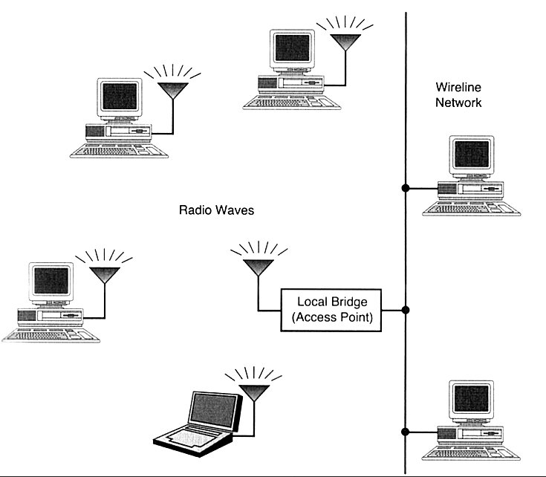
802.11 WLANs - Outline
802.11 bands and layers
Datalink layer
Media access layer
  frames and headers
  CSMA/CA
Physical layer
  frames
  modulation
    Frequency hopping
    Direct sequence
    Infrared
Security
Implementation
Based on: Jim Geier: Wireless LANs, SAMS publishing and IEEE 802 - standards

Slide 7
802.11 WLAN technologies
IEEE 802.11 standards and rates
  IEEE 802.11 (1997) 1 Mbps and 2 Mbps (2.4 GHz band )
  IEEE 802.11b (1999) 11 Mbps (2.4 GHz band) = Wi-Fi
  IEEE 802.11a (1999) 6, 9, 12, 18, 24, 36, 48, 54 Mbps (5 GHz band)
  IEEE 802.11g (2001 ... 2003) up to 54 Mbps (2.4 GHz) backward compatible to 802.11b
  IEEE 802.11n (2009) Multiple-Input-Multiple-Output (MIMO) antennas, 2.4GHz and 5GHz bands, 54-600Mbps
  IEEE 802.11ac (2013-2015), MIMO, more spatial streams, wider channels, up to 1300 Mbps …. IEEE 802.11ax (future)
IEEE 802.11 networks work on license free industrial, science, medicine (ISM) bands (specif. ITU Radio Regulations) :
26 MHz
83.5 MHz
200 MHz
255 MHz
902 928 2400 2484 5150 5350 5470 5725 f/MHz

Slide 8
Other WLAN technologies
High performance LAN or HiperLAN (ETSI-BRAN EN 300 652) in the 5 GHz ISM
  version 1 up to 24 Mbps
  version 2 up to 54 Mbps
HiperLAN provides also QoS for data, video, voice and images
Bluetooth
  range up to 100 meters only (cable replacement tech.)
  Bluetooth Special Interest Group (SIG)
  Operates at max of 740 kbps at 2.4 GHz ISM band
  Applies fast frequency hopping 1600 hops/second
  Can have serious interference with 802.11 2.4 GHz range network

Slide 9
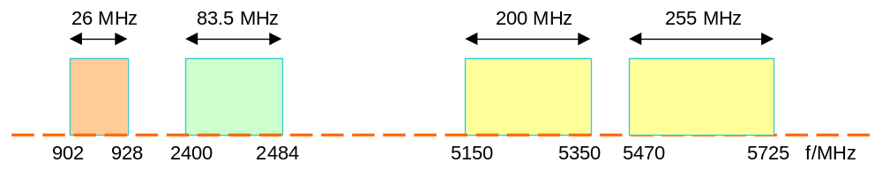
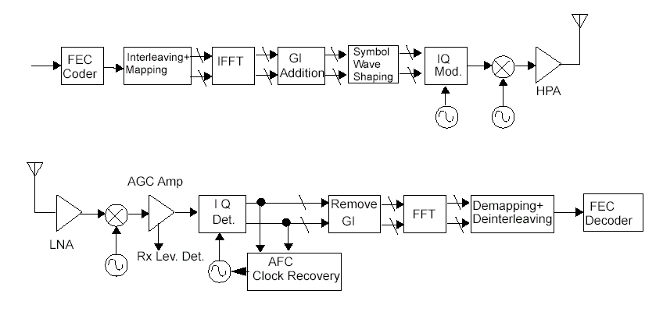
802.11a
Operates at 5 GHz band
Supports multi-rate 6 Mbps, 9 Mbps,… up to 54 Mbps
Use Orthogonal Frequency Division Multiplexing (OFDM) with 52 subcarriers, 4 us symbols (0.8 us guard interval)
Use inverse discrete Fourier transform (IFFT) to combine multi-carrier signals to single time domain symbol

Slide 10
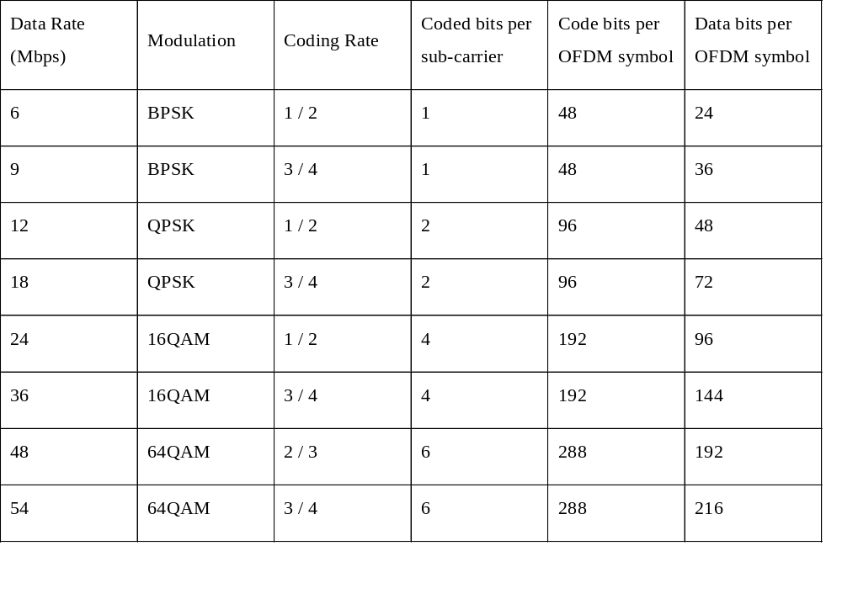
IEEE 802.11a rates and modulation formats

Slide 11
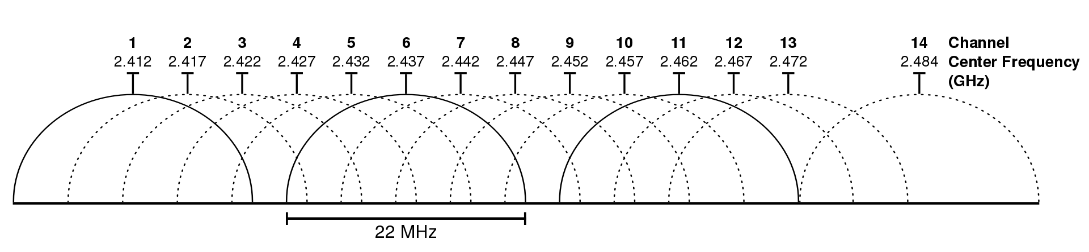
802.11b
obtains a max raw throughput of 11Mbps
uses 2.4GHz band
uses DSSS (Direct-sequence spread spectrum) modulation
uses CSMA/CA (Carrier Sense Multiple Access/Collision Avoidance)

Slide 12
802.11g
obtains a max raw throughput of 54Mbps
uses 2.4GHz band
uses OFDM (Orthogonal Frequency Division Multiplexing) modulation; has 52 OFDM subcarriers with a carrier separation of 0.3125 MHz
uses CSMA/CA (Carrier Sense Multiple Access/Collision Avoidance)
backward compatible with 802.11b (same number of channels)

Slide 13
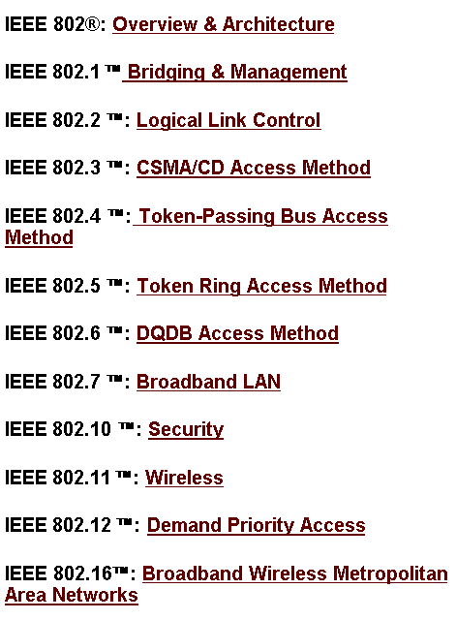


IEEE 802-series of LAN standards
802 standards free to
download from
http://standards.ieee.org
/getieee802/portfolio.html
hub
stations
hub
stations
hub
stations
hub
Demand priority: A round-robin (see token rings-later) arbitration
method to provide LAN access based on message priority level
router
server
DQDB: Distributed queue dual buss, see PSTN lecture 2

Slide 14
The IEEE 802.11 and supporting LAN Standards
IEEE 802.2
Logical Link Control (LLC)
OSI Layer 2
(data link)
IEEE 802.3
Carrier
Sense
IEEE 802.4
Token
Bus
IEEE 802.5
Token
Ring
IEEE 802.11
Wireless
MAC
PHY
OSI Layer 1
(physical)
a
b
g
bus
star
ring
See also IEEE LAN/MAN Standards Committee Web site
www.manta.ieee.org/groups/802/
IEEE 802.3 is Ethernet

Slide 15
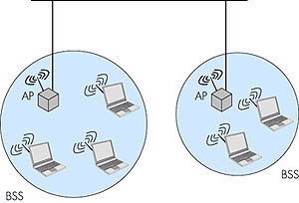
IEEE 802.11 Architecture
IEEE 802.11 defines the physical (PHY), and media access control (MAC) layers for a wireless local area network; the logical link (LLC) is common to Ethernet and Wi-Fi
802.11 networks can work as
  basic service set (BSS)
  extended service set (ESS)
BSS can also be used in ad-hoc
networking
Network
LLC
MAC
802.11
FHSS
PHY
DSSS
IR
DS,
ESS
LLC: Logical Link Control Layer
MAC: Medium Access Control Layer
PHY: Physical Layer
FHSS: Frequency hopping SS
DSSS: Direct sequence SS
SS: Spread spectrum
IR: Infrared light
BSS: Basic Service Set
ESS: Extended Service Set
AP: Access Point
DS: Distribution System
ad-hoc network

Slide 16
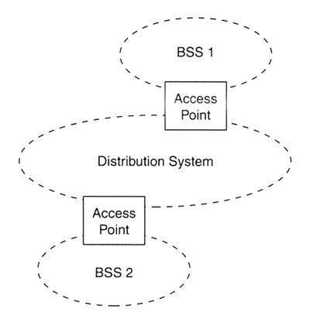
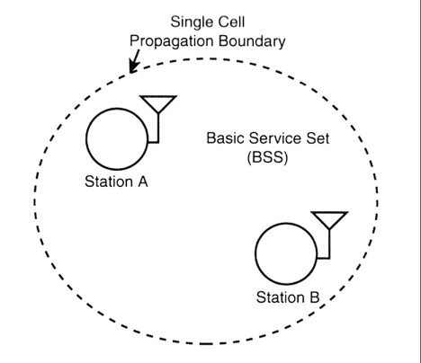
BSS and ESS
Basic (independent) service set (BSS)
Extended service set (ESS)
In ESS multiple access points connected by access points and a distribution system as Ethernet
  BSSs partially overlap
  Physically disjoint BSSs
  Physically collocated BSSs (several antennas)

Slide 17
802.11 Logical architecture
LLC provides
  multiplexing mechanisms for several network protocols (IP, IPX, Decnet, e.g.)
  flow control
  automatic repeat requests (ARQ)
MAC provides
  Control access to wireless medium
  (CSMA/CA)
  Addressing, frame delimiting/preamble
  for synchronization
  protection against errors (frame check sequence)
Three physical layers (PHY)
  FHSS: Frequency Hopping Spread
  Spectrum (SS)
  DSSS: Direct Sequence SS
  IR: Infrared transmission
Network
LLC
MAC
802.11
FHSS
DSSS
IR
PHY
LLC: Logical Link Control Layer
MAC: Medium Access Control Layer
PHY: Physical Layer
FH: Frequency hopping
DS: Direct sequence
IR: Infrared light

Slide 18
802.11 Physical layer (PHY)

Slide 19
Physical layer structure
Physical Layer Convergence Procedure (PLCP) sublayer: prepares MAC frames for transmission into the air; adds a preamble header to the MAC frame
Physical Medium Dependent (PMD) sublayer : transmit (modulate) the bits into the air using an antenna
Datalink layer
PLCP
PMD
Physical layer

Slide 20
Spread spectrum techniques
Spread spectrum works by using mathematical functions to diffuse signal power over a large set of frequencies
It has the advantage that the emitted signal looks like noise and is less prone to interference
Frequency hopping (FHSS) - jump from one frequency to another in a random pattern,transmitting a short burst at each subchannel. The 2-Mbps FH PHY is specified in clause 14
Direct sequence (DSSS) - spread the power out over a wider frequency band using mathematical coding functions. Two direct-sequence layers were specified. The initial specification in clause 15 standardized a 2-Mbps PHY, and 802.11b added clause 18 for the HR/DSSS PHY.
Orthogonal Frequency Division Multiplexing (OFDM) - divides an available channel into several subchannels and encodes a portion of the signal across each subchannel in parallel. The technique is similar to the Discrete Multi-Tone (DMT)technique used by some DSL modems. Clause 17, added with 802.11a, specifies the OFDM PHY. Clause 18, added in 802.11g, specifies the ERP PHY, which is essentially the same but operating at a lower frequency.

Slide 21
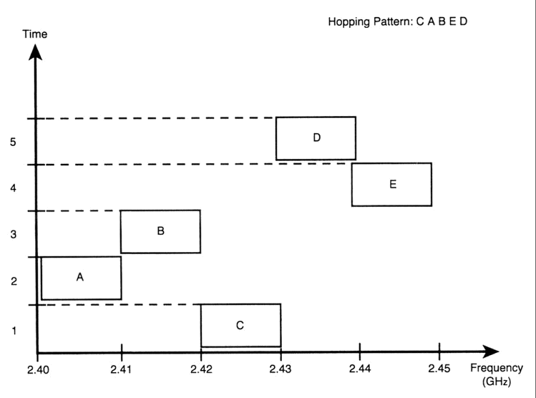
802.11 FHSS
Supports 1 and 2 Mbps data transport and applies two level - GFSK modulation (Gaussian Frequency Shift Keying)
79 channels from 2.402 to 2.480 GHz ( in U.S. and most of EU countries) with 1 MHz channel space
78 hopping sequences with minimum 6 MHz hopping space, each sequence uses every 79 frequency elements once
Minimum hopping rate
2.5 hops/second
Tolerance to multi-path,
narrow band interference,
security
Low speed, small range
due to FCC TX power
regulation (10mW)

Slide 22
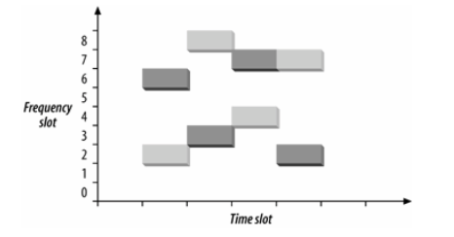
802.11 FHSS details
802.11 divides the ISM band into 1MHZ channels
Modulation used in 802.11 shifts the transmission frequency from the channel center
Channels are defined by their central frequency: channel 0 has 2.400GHz , channel 1 has 2.401GHz, channel 2 has 2.402GHz…
The standard also defines sets of approx. 26 orthogonal hopping patterns (depending on the country)
If the hopping patterns are orthogonal (i.e. they don’t overlap) for two users, there won’t be interferences between them
In the following figure we have two orthogonal hopping patterns : {2, 8, 4, 7} and {6, 3, 7, 2}

Slide 23
802.11 FHSS details (cont.)
Beacon frames specify the hop pattern number (hop pattern are standardized), timestamp and current hop index
A station can synchronize its frequency to the current hop specified by the beacon frame
A station can spend 0.4 seconds in one hop channel
Limitation: a channel has 1MHz bandwidth; 1 bit per cycle => 1Mbps maximum throughput

Slide 24
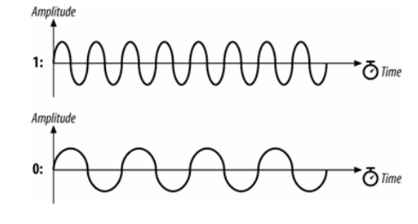
FHSS modulation. 2-level GFSK
(Gaussian Frequency Shift Keying)
2 frequencies are used for bit values 1 and 0: the central frequency increased by a level and the central frequency decreased by the same level

Slide 25
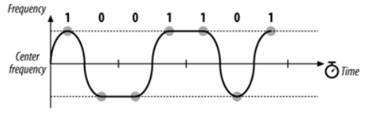
2-level GFSK modulation example
Each symbol is modulated for a specific constant period of time
In the middle of the symbol period, the receiver measures the frequency of the transmission and translates it into a symbol
Usually the payload bit data is scrambled (whitened) before transmission
Example of modulating the bit sequence 1001101:

Slide 26
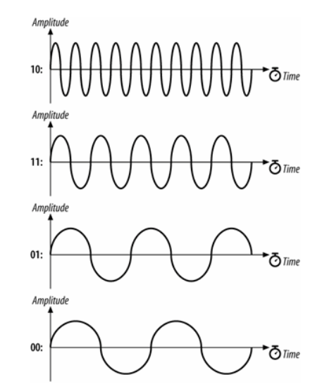
4-level GFSK
There are 4 frequencies around the central frequency
4 symbols are encoded: 00, 01, 10, 11

Slide 27
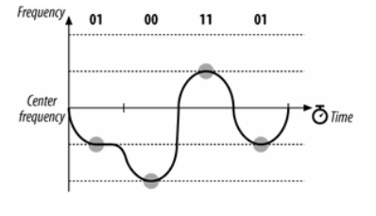
4-level GFSK modulation example
Encoding the same bit sequence 1001101

Slide 28
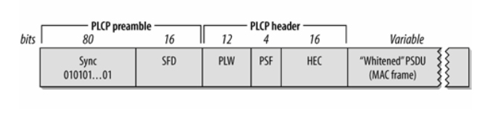
FHSS Physical Layer Convergence Procedure (PLCP) sublayer
The PLCP sublayer adds a header+preamble to the MAC frame it receives:
Preamble – it synchronizes the transmitter and receiver (like in Ethernet)
  Sync – 80 bits of alternating 0 and 1 (010101…); stations know that after the sync pattern they should prepare to receive data
  SFD (Start Frame Delimiter) – signals the end of preamble and beginning of a new frame; has the value: 0000 1100 1011 1101
Header
  PSDU (PLCP Service Data Unit) Length Words (PLW) – the length of the MAC frame following this header (12 bits)
  PSF (PLCP Signaling) - bit 1 is zero, bits 2-4 encode the transmission speed of this frame(e.g. 001 = 1.5Mbps)
  HEC (Header Error Check) – 16-bit CRC calculated over the header

Slide 29
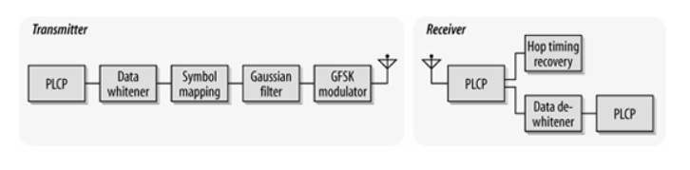
Frequency hopping transceiver (transmitter-receiver)
the PLCP preamble is transmitted in 96us (preamble symbols are transmitted at 1MHz, so a symbol takes 1 us, to transmit; 96 bits require 96us)
the PLCP header is transmitted in 32us (it has 32 bits, do it requires 32 symbol times)
max size of a MAC frame 4095 bytes

Slide 30
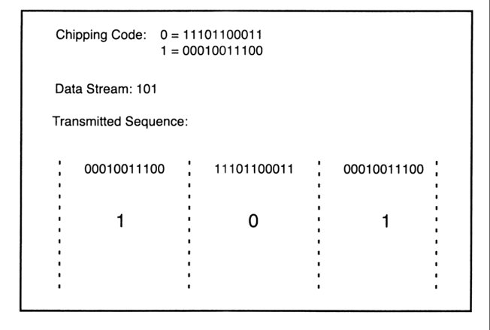
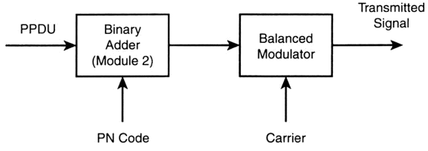
802.11 DSSS
DS-transmitter
Supports 1 and 2 Mbps data transport, uses BPSK and QPSK modulation (802.11b supports 5.5MHz and 11MHz)
Uses 11 chips Barker (10110111000) code for spreading - 10.4 dB processing gain
Defines 14 overlapping channels, each having 22 MHz channel bandwidth, from 2.401 to 2.483 GHz
Power limits 1000mW in US, 100mW in EU, 200mW in Japan
Immune to narrow-band interference, cheaper hardware
PPDU:baseband data frame

Slide 31
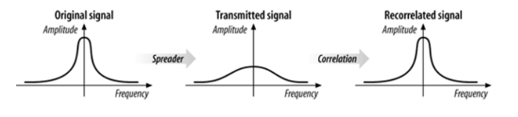
Direct Sequence Spread Spectrum technique
The idea is to spread the signal over a wider frequency band
This makes the transmitted signal look like low-level noise (i.e. more resilient to noise)
The bitstream is modulated using a chiper that changes at a much higher rate than the original bitstream (the high speed oscillator required to produce the chip stream is a major power drain of the PHY layer)

Slide 32
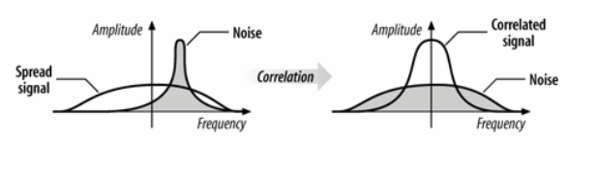
DSSS. Spreading the noise at receiver
Noise tends to have the form of narrow pulses and does not produce effects across the entire frequency band
The receiver spreads the noise and the signal is outlined

Slide 33
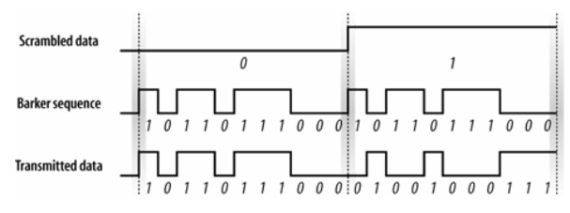
DSSS encoding example
The Baker 11-bit chip word is: 10110111000
This chip is modulo 2 added to the data bit

Slide 34
Radio spectrum in DSSS
DSSS channels are much wider than FHSS channels
DSSS physical level has 14 channels, each 5MHz wide
Channel 1 has central freq. 2.412GHz, channel 2 has the central freq. 2.417GHz and .. channel 13 has the freq. 2.472GHz
DSSS is more robust than FHSS
Several bits need to be damaged in order for a single data bit to be lost.

Slide 35
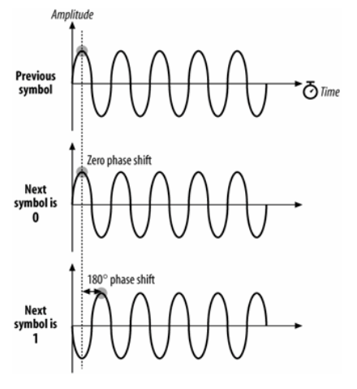
Modulation for DSSS. Differential Binary Phase Shift Keying (DBPSK)
two carrier waves, one reference wave (phase 0) is used to encode a 0, a half-cycled shifted wave is used to encode a 1 (phase π)

Slide 36
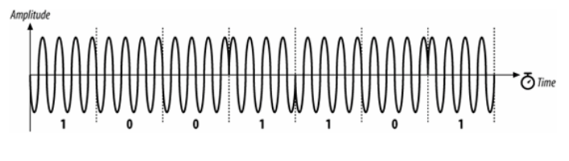
DBPSK example
Encoding 1001101

Slide 37
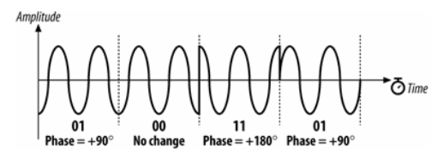
Modulation for DSSS. Differential Quadrature Phase Shift Keying (DQPSK)
4 symbols:
    00 is encoded with a 0 phase shift,
    01 is encoded with a π/2 phase shift
    10 is encoded with a π phase shift
    11 is encoded with a 3 π/2 phase shift
Encoding 01001101:

Slide 38
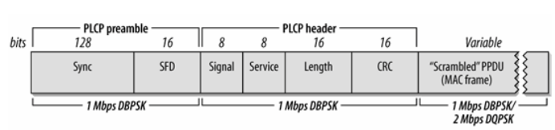
DSSS Physical Layer Convergence Procedure (PLCP) sublayer
The PLCP sublayer adds a header+preamble to the MAC frame it receives:
Preamble – it synchronizes the transmitter and receiver (like in Ethernet)
  Sync – 128 bits of value 1; stations know that after the sync pattern they should prepare to receive data
  SFD (Start Frame Delimiter) – signals the end of preamble and beginning of a new frame; has the value: 0000 0101 1100 1111; allows the receiver to find start of frame even if sync bits were lost
Header
  Signaling - identified transmission speed bit: 0000 1010 = 1 Mbps operation, 0001 0100 = 2Mbps
  Service – all zeros
  Length – number of microseconds required to transmit the frame
  HEC (Header Error Check) – 16-bit CRC calculated over the header

Slide 39
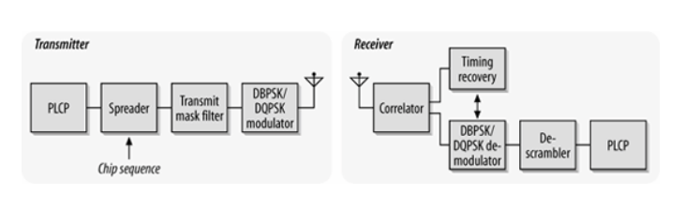
DSSS transceiver (transmitter-receiver)
the PLCP preamble is transmitted in 144us (preamble symbols are transmitted at 1MHz, so a symbol takes 1 us, to transmit; 144 bits require 144us)
the PLCP header is transmitted in 48us (it has 48 bits, do it requires 48 symbol times)
max size of a MAC frame 8191 bytes

Slide 40
How ring-network works
A node functions as a repeater
only destination copies
frame to it,
all other nodes
have to discarded
the frame
Unidirectional link
A
A
C
A
B
C
A
B
B transmits frame
addressed to A
C ignores frame
A
A
C
A
B
C
B
A
A copies frame
C absorbs
returning frame

Slide 41
Token ring
A ring consists of a single or dual (FDDI) cable in the shape of a loop
Each station is only connected to each of its two nearest neighbors. Data in the form of packets pass around the ring from one station to another in uni-directional way.
Advantages :
  (1) Access method supports heavy load without degradation of performance because the medium is not shared.
  (2) Several packets can simultaneous circulate between different pairs of stations.
Disadvantages:
  (1) Complex management
  (2) Re-initialization of the ring whenever a failure occurs

Slide 42
How bus-network works
In a bus network, one node’s transmission traverses the entire network and is received and examined by every node. The access method can be :
  (1) Contention scheme : multiple nodes attempt to access bus; only one node succeed at a time (e.g. CSMA/CD in Ethernet)
  (2) Round robin scheme : a token is passed between nodes; node holds the token can use the bus (e.g.Token bus)
Advantages:
  (1) Simple access method
  (2) Easy to add or remove
  stations
Disadvantages:
  (1) Poor efficiency with high
  network load
  (2) Relatively insecure, due to
  the shared medium
A
B
C
D
D
term
term
term: terminator impedance

Slide 43
MAC Techniques - overview
Contention
  Medium is free for all
  A node senses the free medium and occupies it as long as data packet requires it
  Example: Ethernet (CSMA), IEEE 802.3
Token ring
  Gives everybody a turn
  reservation time depends on token holding time (set by network operator)
  for heavy loaded networks
  Example: Token Ring/IEEE 802.5, Token Bus/IEEE 802.4, FDDI
Reservation (long term)
  link reservation for multiple packets
  Example: schedule a time slot: GSM using TDMA

Slide 44
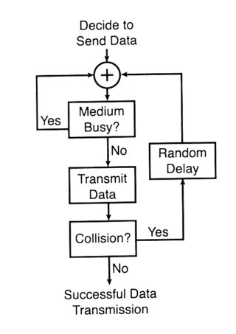
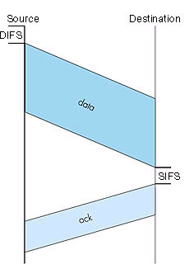
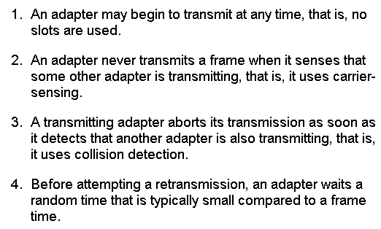
IEEE 802.11 Media
Access Control (MAC)
Carrier-sense multiple access protocol
with collision avoidance (CSMA/CA)
DIFS: Distributed Inter-Frame Spacing
SIFS: Short Inter-Frame Spacing
ack: Acknowledgement

Slide 45
IEEE 802.11 Media Access Control (cont.)
There are various time intervals involved in 802.11 MAC CSMA/CA:
  DIFS (DCF [Distributed Coordination Function] Interframe Space) – minimum idle time before a station can access the medium
  SIFS (Short Interframe Space) – minimum idle time before a station can access the medium; used for highest-priority transmissions like RTS (Request to Send) and CTS (Clear to Send); SIFS < DIFS
802.11 MAC uses positive acknowledgement due to increased error rate of the wireless medium (each frame should be acknowledged by the receiver, otherwise retransmitted)
A sender may send a RTS frame to inform other stations that it wants to transmit (no other station is allowed to transmit in this period) and all stations should reply with CTS – only in high contention environments

Slide 46
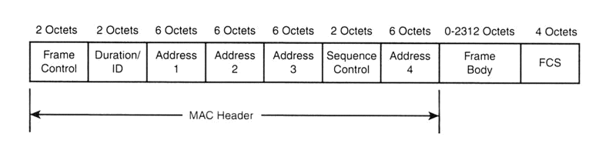
MAC frame (802.11 Wireless)
NOTE: This frame structure is common for all data send by a 802.11 station
control info (WEP, data type as management, control, data ...)
frame ordering
info for RX
frame transmission duration
-Basic service identification*
-source/destination address
-transmitting station
-receiving station
frame specific,
variable length
frame check
sequence
(CRC)
*BSSID: a six-byte address typical for a particular
access point (network administrator sets)

Slide 47

MAC Frame. Frame Control field
Protocol version – 2 bits, value 00
Type and Subtype – the type+subtype of frame (data frame or management):
  Type =00 (management frame), subtypes: 0000 (association req.), 0001 (association response), 0100 (probe req.), 0101 (probe resp.), 1000 (beacon), 1010 (disassociation), 1011 (authentication)..
  Type=01 (control frame), subtypes: 1010 (power save), 1011 (RTS), 1100 (CTS), 1101 (acknowledgement), …
  Type=10 (data frame), subtypes: 0000 (data), 0001 (Data+CF-Ack), …
To DS, From DS (DS=Distribution System, the wired network) – indicates whether the frame is from wireless to wired network or inverse

Slide 48
MAC Frame. Frame Control field (cont.)
More Fragments bit – indicates that more fragments of this frame will follow
Retry bit – this is a retransmitted frame
Power Management bit – indicates if the sender will be in the powersaving mode after this send
More data bit – indicates that more frames are buffered and ready to be transmitted (for powersaving receivers)
Protected Frame bit – if this frame is encrypted (WEP, WPA, WPA2)

Slide 49
MAC Frame. Types of MAC addresses
Destination address – the final recipient (station) of this frame
Source address – the station that is the source of this frame
Receiver address – either the final destination or the access point
Transmitter address – the access point that transmitted this frame in the wireless network

Slide 50
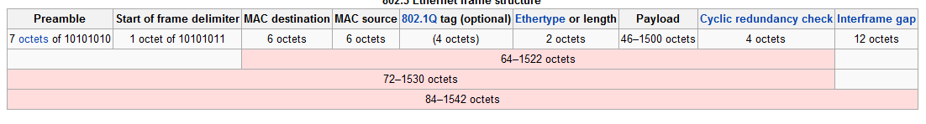
Mac Frame (802.3 Ethernet)

Slide 51
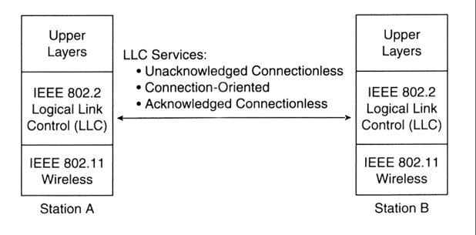
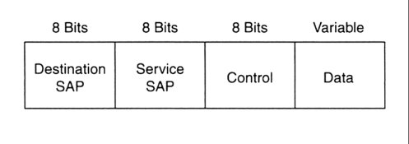
Logical Link Control Layer (LLC)
Specified by ISO/IEC 8802-2 (ANSI/IEEE 802.2)
purpose: exchange data between users across LAN using 802-based MAC controlled link
provides addressing and data link control, independent of topology, medium, and chosen MAC access method
Data to higher level protocols
Info: carries user data
Supervisory: carries
flow/error control
Unnumbered: carries protocol
control data
Source
SAP
LLC’s functionalities
LLC’s protocol data unit (PDU)
SAP: service address point

Slide 52
Logical Link Control Layer Services
A Unacknowledged connectionless service
  no error or flow control - no ack-signal usage
  unicast (individual), multicast, broadcast addressing
  higher levels take care or reliability - thus fast for instance for TCP
B Connection oriented service
  supports unicast only
  error and flow control for lost/damaged data packets by cyclic redundancy check (CRC)
C Acknowledged connectionless service
  ack-signal used
  error and flow control by stop-and-wait ARQ
  faster setup than for B

Slide 53
ARQ (Automatic Repeat Request) Techniques (acknowledgement/retransmission)
forward
channel
erroneous frame
correct pre-send frames
correct post-send frames
‘corrected’ frame
ARQ-system:
TX-buffer
RX-buffer
acknowledgment
negative ack. received
n-1 frames send due
to RX-TX propagation
delay
TX-buffer
erroneous frame re-send only
TX-buffer
n frames to be re-send
RX-buffer
Selective repeat
RX-buffer
Go-back-n
- reordering might be required in RX
- large buffer required in TX
- also correct frames re-send
- small receiver buffer size enough
- no reordering in RX
Stop-and-wait
- for each packet wait for ack.
- if negative ack received, re-send packet
- inefficient if long propagation delays

Slide 54
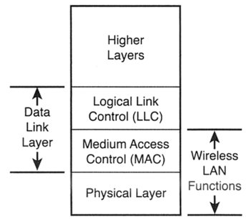
A TCP/IP packet in 802.11
TPC/IP send data packet
Control
header
LLC constructs PDU by
adding a control header
SAP (service access point)
MAC frame with
new control fields
MAC lines up packets using carrier
sense multiple access (CSMA)
PHY layer transmits packet
using a modulation method
(DSSS, OFDM, IR, FHSS)
Traffic to the
target BSS / ESS
*PDU: protocol data unit

Slide 55
Encapsulation of IP packet in 802.11 LLC+MAC frame
MAC
headers
SNAP
DSAP
SNAP
SSAP
Control
Ethernet tunnel/RFC 1042 encapsulation
Type
IP packet
FCS
SNAP header
Type=0x0800 (IP), 0x806 (ARP)

Slide 56
IEEE 802.11 Mobility
Standard defines the following mobility types:
  No-transition: no movement or moving within a local BSS
  BSS-transition: station movies from one BSS in one ESS to another BSS within the same ESS
  ESS-transition: station moves from a BSS in one ESS to a BSS in a different ESS (continuos roaming not supported)
Especially: 802.11 don’t support roaming with GSM!
- Address to destination
mapping
- seamless integration
of multiple BSS
ESS 1
ESS 2

Slide 57
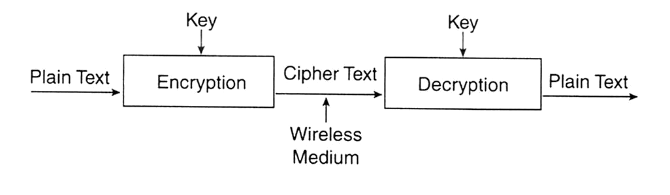
Authentication and privacy
Goal: to prevent unauthorized access & eavesdropping
Realized by authentication service prior access
Open system authentication
  station wanting to authenticate sends authentication management frame - receiving station sends back frame for successful authentication
Shared key authentication (included in WEP*)
  Secret, shared key received by all stations by a separate, 802.11 independent channel
  Stations authenticate by a shared knowledge of the key properties
WEP’s privacy (blocking out eavesdropping) is based on ciphering:
*WEP: Wired Equivalent Privacy

Slide 58
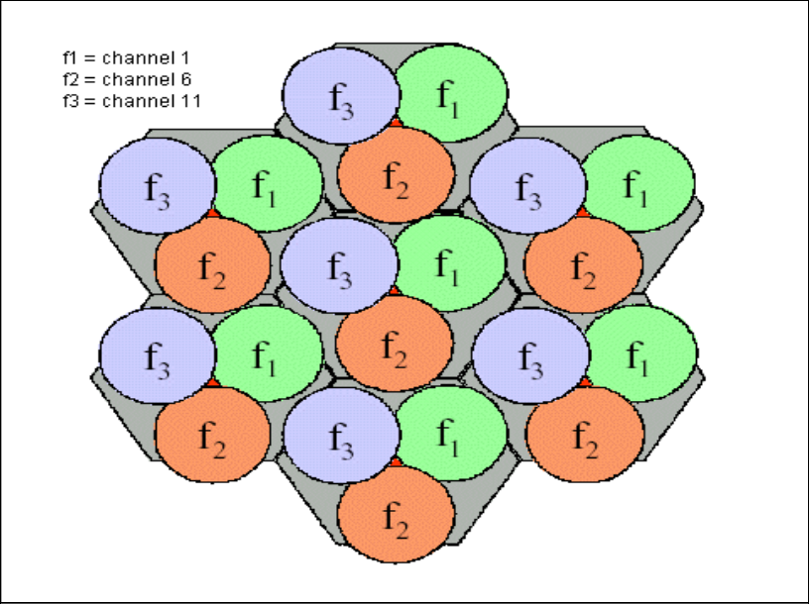
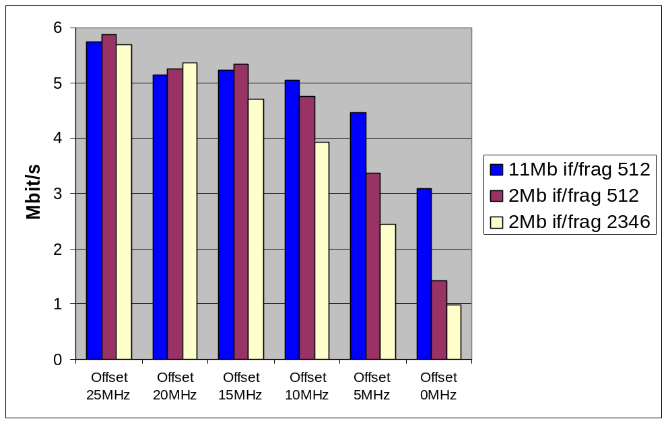
Frequency planning
Interference from other WLAN systems or cells
IEEE 802.11 operates at uncontrolled ISM band
14 channels of 802.11 are overlapping, only 3 channels are disjointed. For example Ch1, 6, 11
Throughput decreases with less channel spacing
A example of frequency allocation in multi-cell network

Slide 59
WLAN benefits
Mobility
  increases working efficiency and productivity
  extends the On-line period
Installation on difficult-to-wire areas
  inside buildings
  road crossings
Increased reliability
  Note: Pay attention to security!
Reduced installation time
  cabling time and convenient to users and difficult-to-wire cases

Slide 60
WLAN benefits (cont.)
Broadband
  11 Mbps for 802.11b
  54 Mbps for 802.11a/g (GSM:9.6Kbps, HCSCD:~40Kbps, GPRS:~160Kbps, WCDMA:up to 2Mbps)
Long-term cost savings
  O & M cheaper that for wired nets
  Comes from easy maintenance, cabling cost, working efficiency and accuracy
  Network can be established in a new location just by moving the PCs!

Slide 61
WLAN technology problems
Date Speed
  IEEE 802.11b support up to 11 MBps, sometimes this is not enough - far lower than 100 Mbps fast Ethernet
Interference
  Works in ISM band, share same frequency with microwave oven, Bluetooth, and others
Security
  Current WEP algorithm is weak - usually not ON!
Roaming
  No industry standard is available and propriety solution are not interoperable - especially with GSM
Inter-operability
  Only few basic functionality are interoperable, other vendor’s features can’t be used in a mixed network

Slide 62
WLAN implementation problems
Lack of wireless networking experience for most IT engineer
No well-recognized operation process on network implementation
Selecting access points with ‘Best Guess’ method
Unaware of interference from/to other networks
Weak security policy
As a result, your WLAN may have
  Poor performance (coverage, throughput, capacity, security)
  Unstable service
  Customer dissatisfaction

